Slide 1
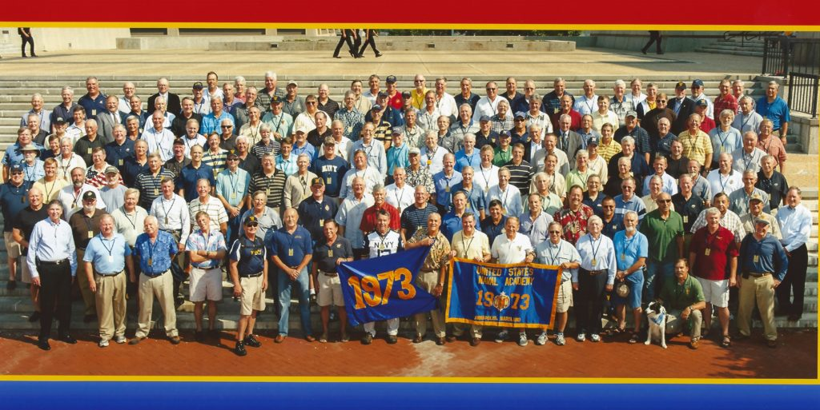
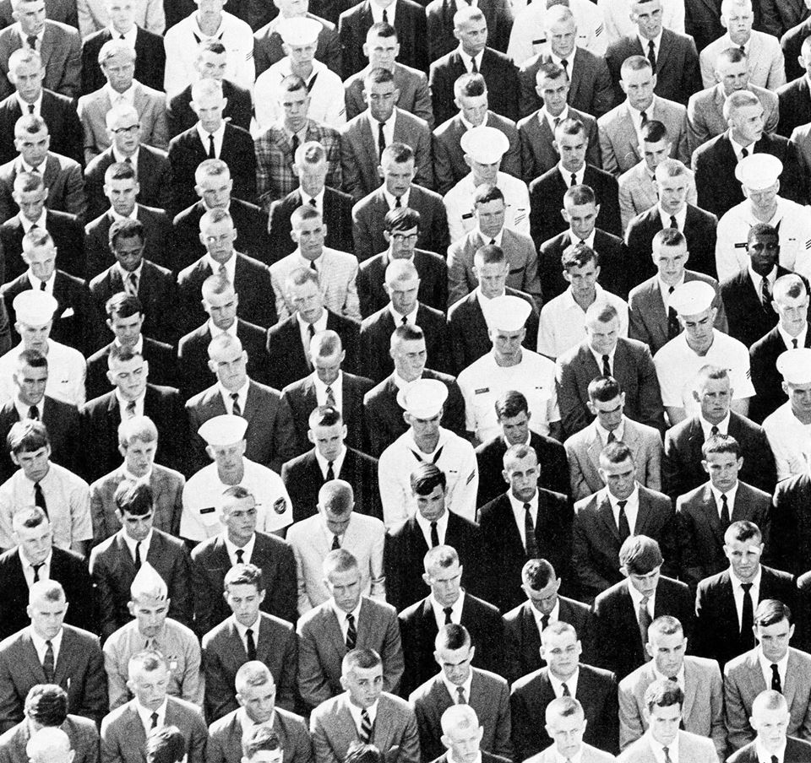
Another Link in the Chain
(ALITC)
USNA’s Great Class of Class of 1973
welcomes……
USNA’s (future Great) Class of 2023

Slide 2
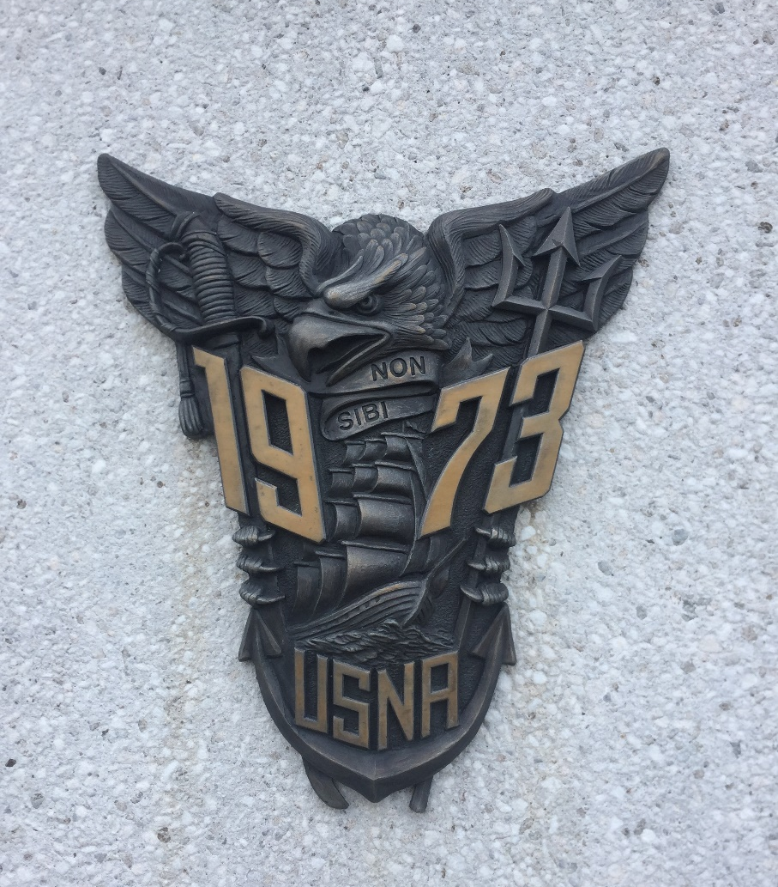
Non Sibi, Sed Patriae
Not for Self, But for Country

Slide 3
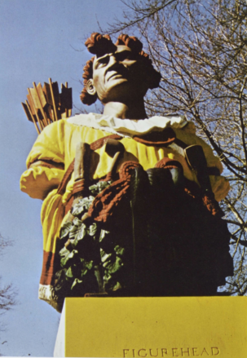
ALITC Purpose
Form bonds and relationships between the Class of 1973 and the Class of 2023 throughout 23’s four years on The Yard and beyond.
Provide encouragement over the years and physical presence for milestone events.
Carry on the history, traditions, and legacy of the Naval Academy.
A legacy is anything handed down from the past, as from an ancestor or predecessor.

Slide 4

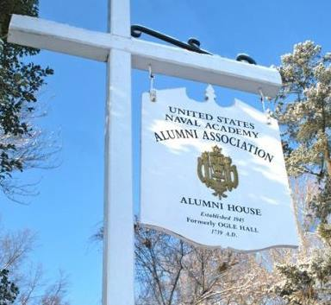
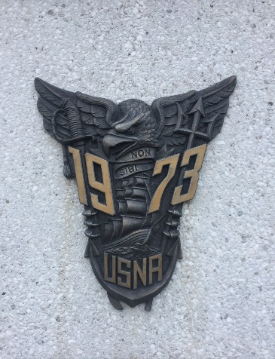
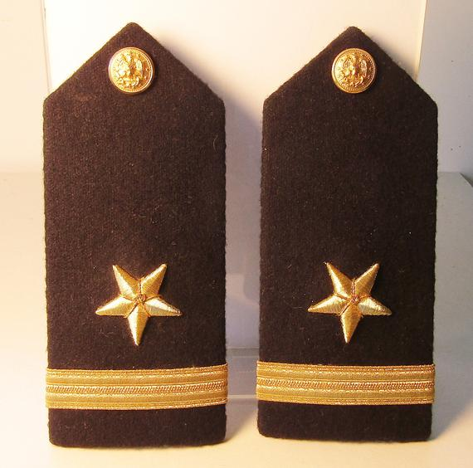
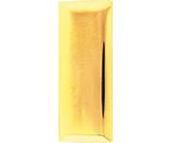
Who are the Participants in the ALITC Program?
The Commandant’s Office directs
The Alumni Association manages
The Class of ‘73 executes
The Class of ‘23 benefits *
* Legacy contributions from earlier classes helps inform and formulate the culture of the Class of ‘23

Slide 5
How long does the ALITC Program last?
Begins NOW with Class of ’73 engagement with Parents Clubs, Alumni Chapters, Blue and Gold Officers, and Shared Interest Groups.
Ends formally when the last member of the Class of 2023 graduates.
Continues as long as the bonds and relationships exist.
---the 1973 Class Legacy endures the passing of its members---

Slide 6
What will the Great Class of ‘73
emphasize
To the Class of ’23?
The Brigade Honor Concept as an ethical way of life.
“Non Sibi” as a lifelong commitment to the Naval Service and the Nation.
………………………..These precepts purposely set a high bar…………………………………

Slide 7
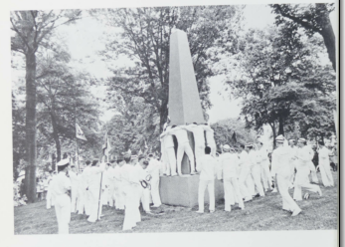
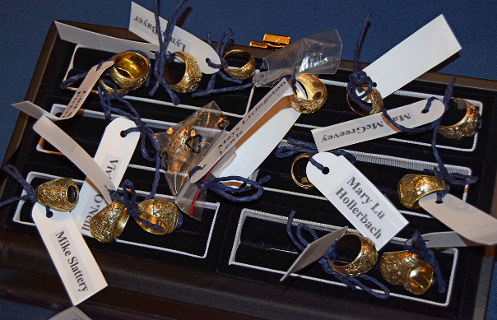
Milestones
Plebe Year
Induction Day Oath of Office
Honor Coin Ceremony
Sea Trials
Herndon Climb
Youngster Year
Bond of Gold
Youngster Luau

Slide 8
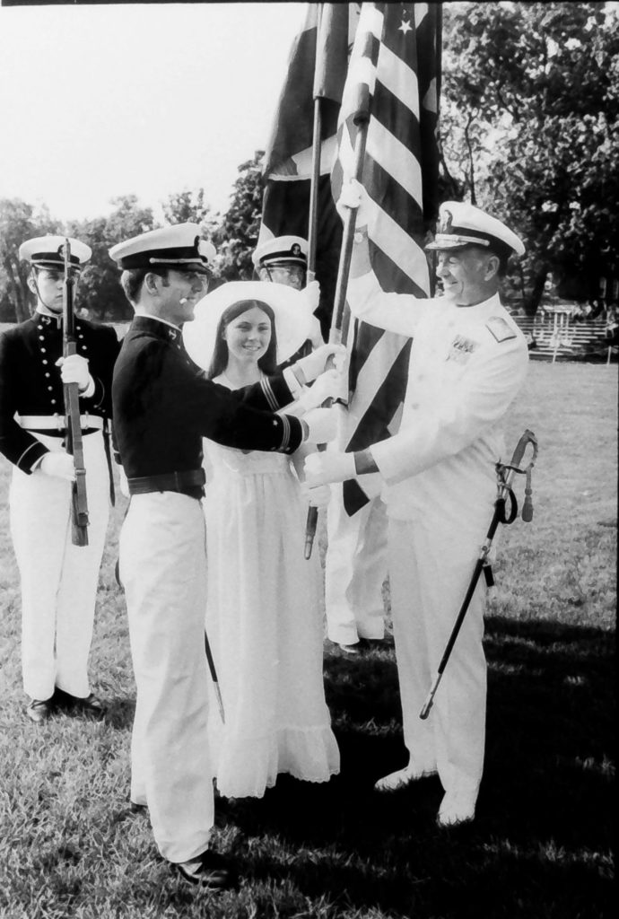

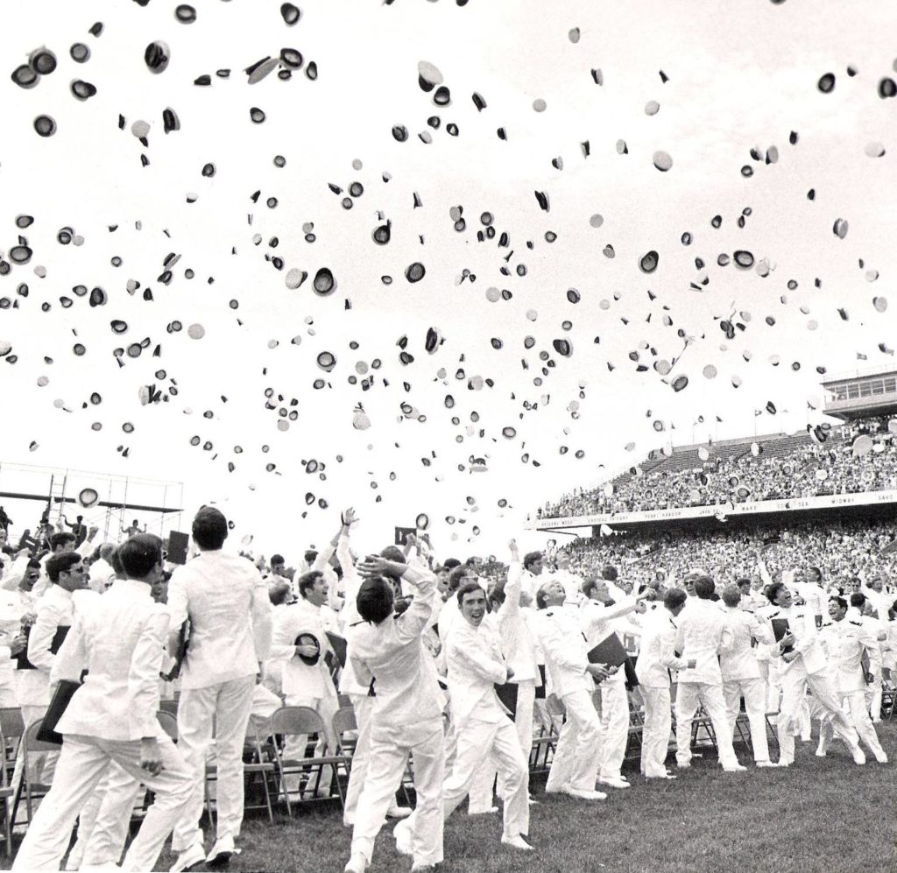
Milestones
Second Class Year
  Commitment Dinner
  Ring Dance
First Class Year
  Service Selection Assignment Dinner
  Battalion Receptions
  Graduation Week

Slide 9
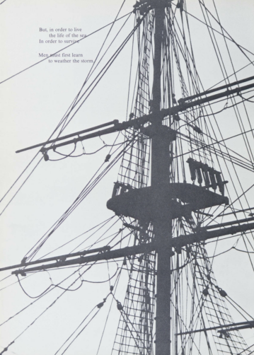
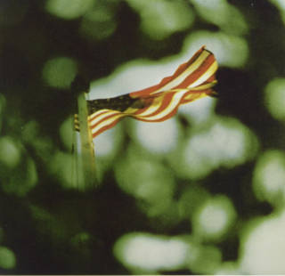
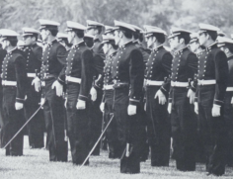
Our Commitment
To the Class of 2023: We’re here for the long haul !!!
“Non Sibi”

Slide 10
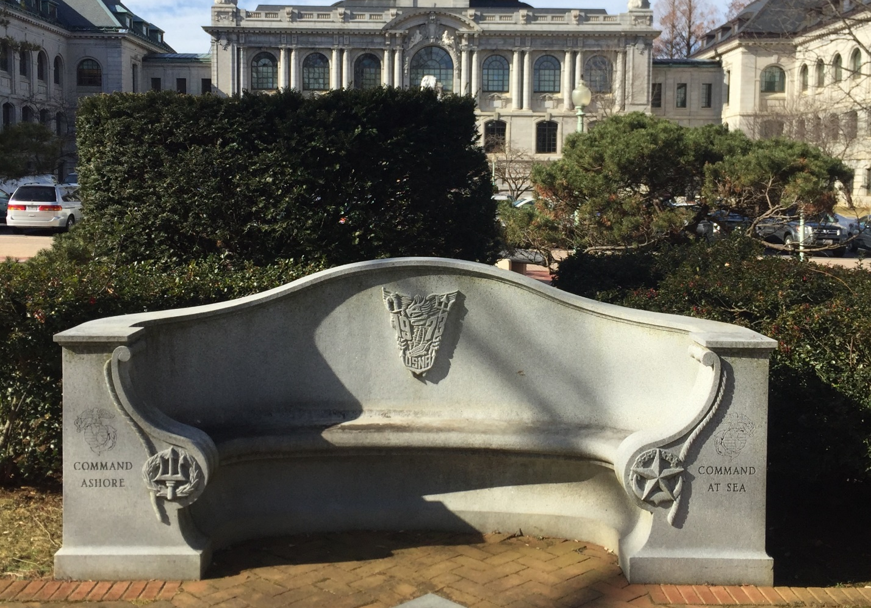
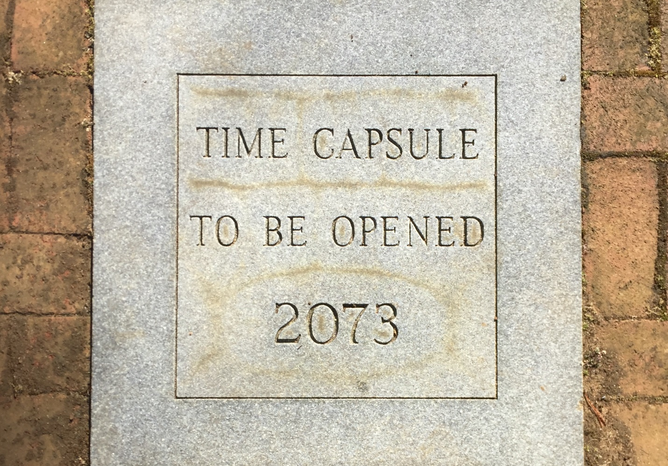
Finding the Class of ‘73 in the Yard – Now and in the Future

Slide 11
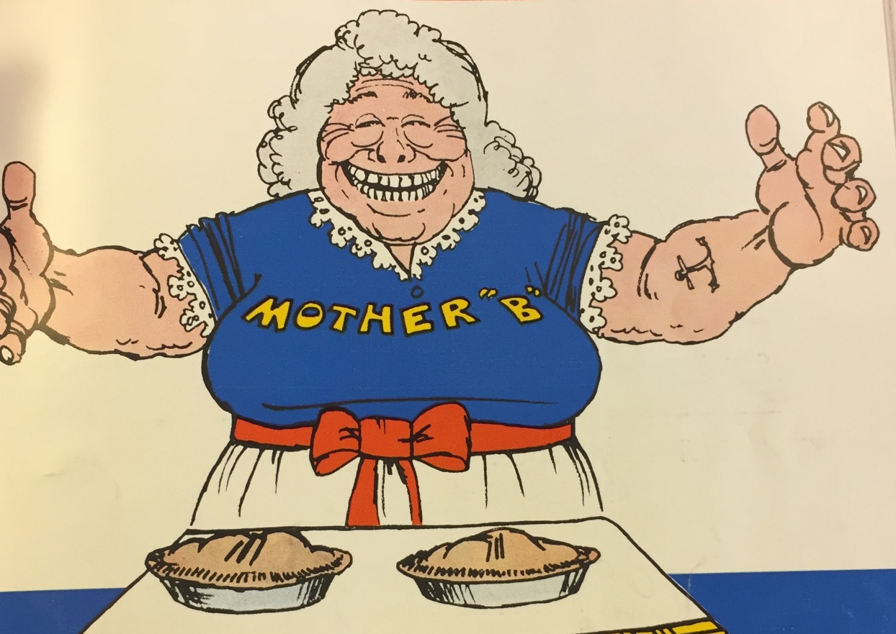
Coming Soon
We’ll see you I-Day, Thursday June 27th, 2019 at Hospital Point at the Plebe Parents Picnic.

