Slide 1



USNA Class of 1980
Memorial Service
Friday 28 May 2020
Slide Show By Bill Personius, 10th Company

Slide 2

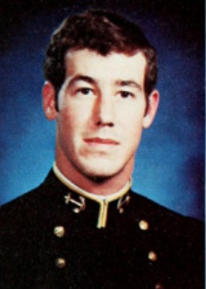
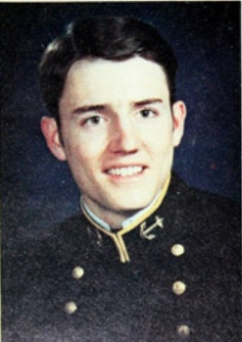
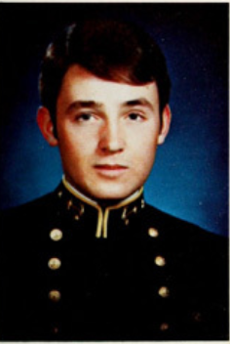
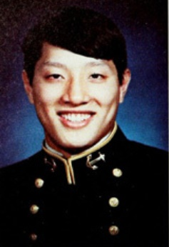
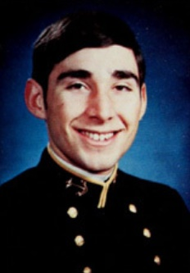
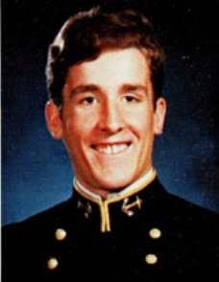
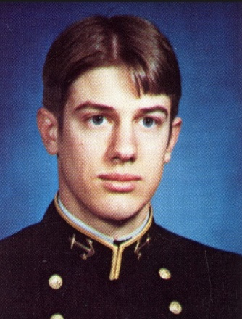
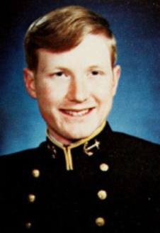
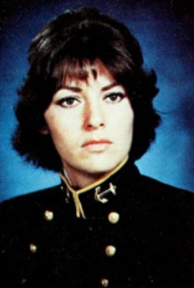
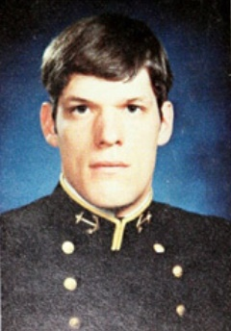
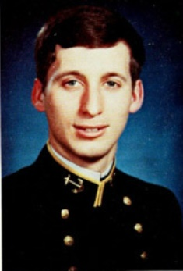
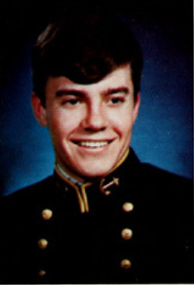
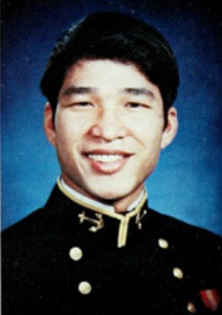
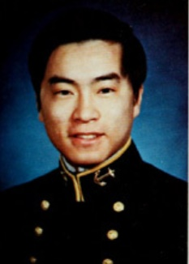
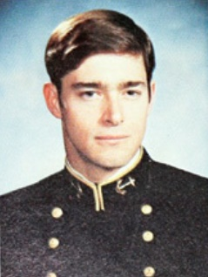
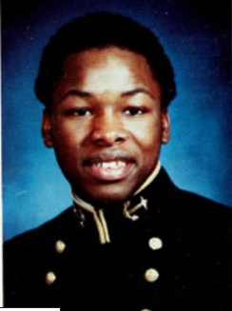
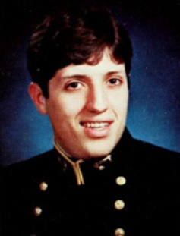
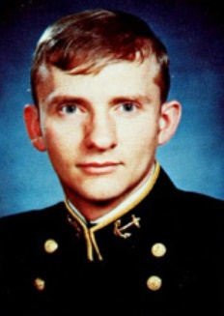
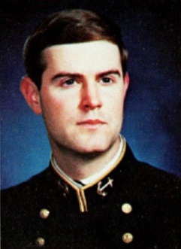
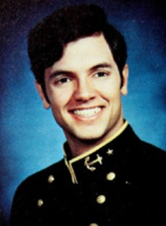
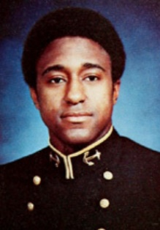
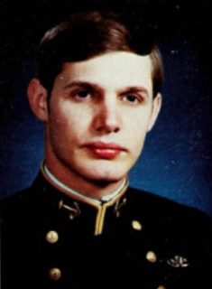
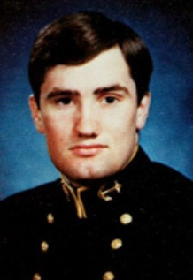
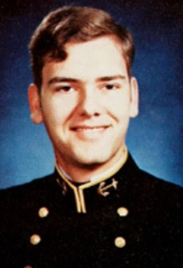
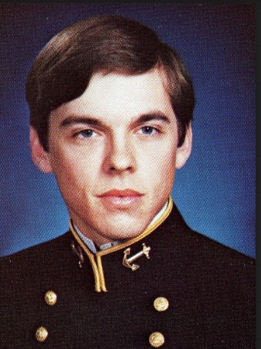
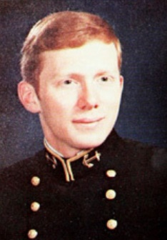
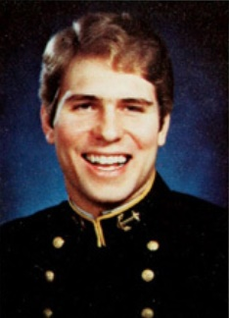
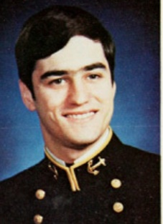
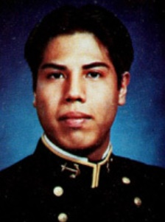
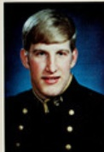
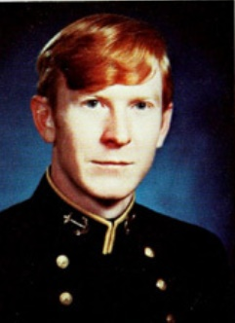
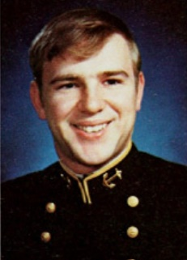
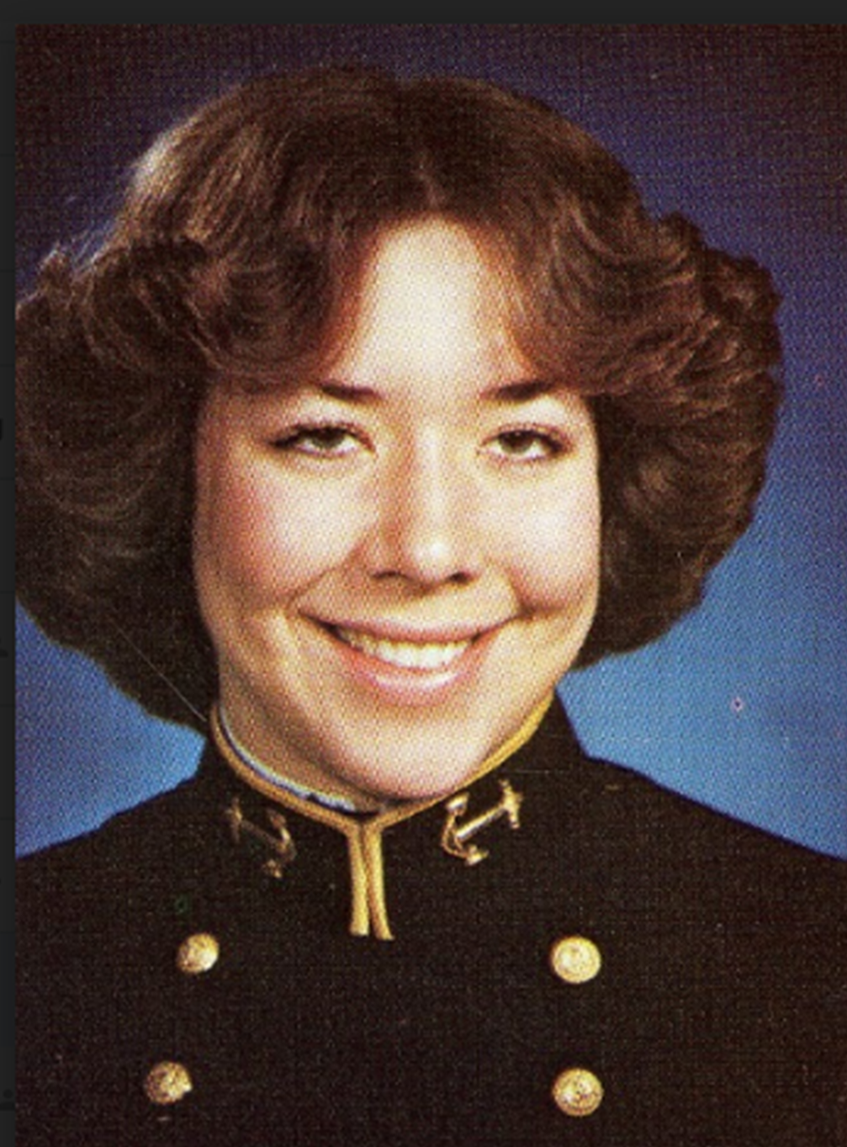
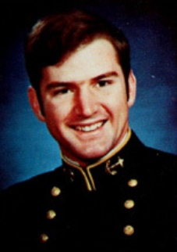
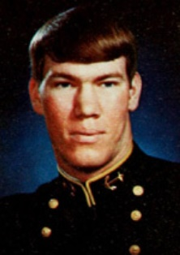
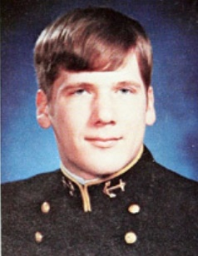
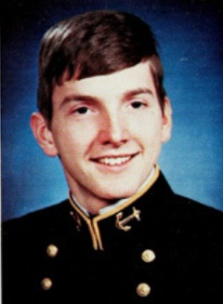
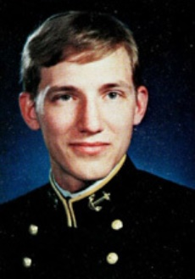
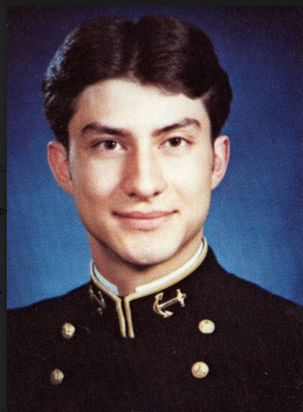
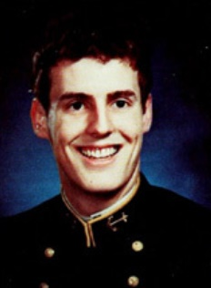
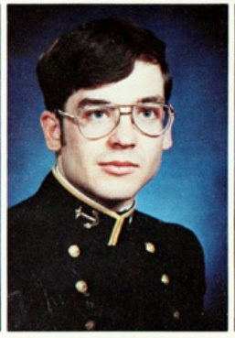
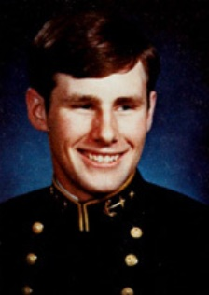
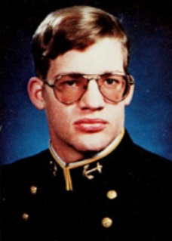
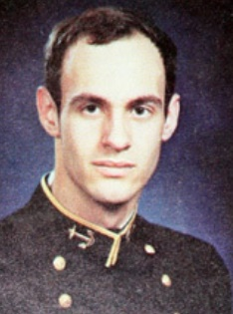
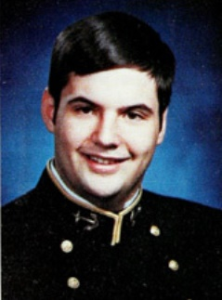
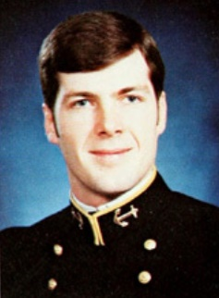
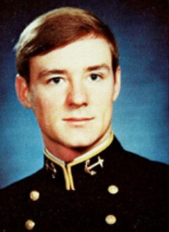
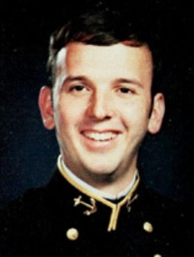
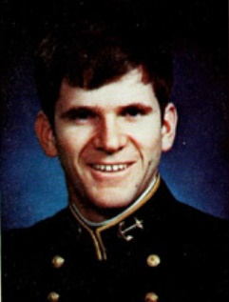
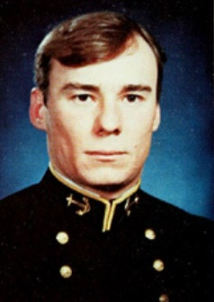













USNA Class of 1980
Memorial Service
USNA Memorial
Class of 1980
Heroes
For Those That Have
Passed Away Too Soon
63 Graduates + 28 Non-Graduates = 91 Total

Slide 3

First Company
1

Slide 4


Karl J. Butterbrodt
25 August 2014

Slide 5

Jeffrey H. Tuset
6 May 1985

Slide 6

Craig J. Philip
8 June 1993
Non-Graduate

Slide 7

Second Company
2

Slide 8

William L. Brodhag
16 May 2018

Slide 9

Third Company
3

Slide 10

Patrick K. Inglis
22 May 1983

Slide 11

Hansen D. Pickerl
27 April 2012

Slide 12

Fourth Company
4

Slide 13

Anthony G. Gragg
26 June 1986

Slide 14

Fifth Company
5

Slide 15

William B. Blackwell
12 December 2004

Slide 16

Larry J. Burks
25 January 2019

Slide 17

Mark D. Lundgren
23 July 2003

Slide 18

James B. McGee
4 November 2015

Slide 19

Sharon L. Sheffield/Raum
12 April 2011

Slide 20

Sixth Company
6

Slide 21

Miles E. Hale
22 December 2011

Slide 22

Alex P. Madarasz
5 May 2016
Non-Graduate

Slide 23

Seventh Company
7

Slide 24

Leslie M. Hahn
17 March 2020

Slide 25

David A. Kish
9 May 1996

Slide 26

Robert B. Powers
1 September 2005

Slide 27

Timothy J. Puls
11 July 2010
Non-Graduate

Slide 28
Carl Sutter
18 May 2012

Slide 29

Eigth Company
8

Slide 30

Steven M. Moreau
7 August 1987

Slide 31

Michael L. Seaward
1 Jan 2021

Slide 32

Ninth Company
9

Slide 33

Daniel W. Davenport
13 September 2013

Slide 34

Cynthia S. Grubbs
24 November 1983

Slide 35
Jean-Pierre Hill
22 August 2017

Slide 36

Tenth Company
10

Slide 37

Marshall W. Atkins
21 April 1993

Slide 38

Johnny B. Esparza
16 March 2007

Slide 39

Vince A. McCall
20 Feb 2014
Non-Graduate

Slide 40

Elizabeth A. Stein/Whitehouse
24 August 2017
Non-Graduate

Slide 41

Eleventh Company
11

Slide 42

Richard P. Bott
7 October 2008

Slide 43

David C. Ernest
21 January 1991

Slide 44

Steven C. Head
5 June 2015

Slide 45
Paul M. Brissette
5 October 1991
Non-Graduate

Slide 46

Edwin A. Crawford
9 October 1988
Non-Graduate
Carl B. Clark
19 October 1987

Slide 47

Stephen C. Lantz
13 May 1979
Non-Graduate

Slide 48

Twelfth Company
12

Slide 49

Jon C. Pino
23 July 1982

Slide 50

Kenneth Kazuyoshi Reilly
12 March 2016
Non-Graduate

Slide 51

Thirteenth Company
13

Slide 52

Carlos A. Miller
23 January 1985

Slide 53

Clayton J. Hogue
3 March 2016
Non-Graduate

Slide 54

Fourteenth Company
14

Slide 55

Bradley A. Peterson
7 March 2012

Slide 56

Fifteenth Company
15

Slide 57
Marc S. Brett
13 September 2008
Non-Graduate

Slide 58

Richard A. Flack
14 June 2012

Slide 59
Nicholas C. Harman
30 September 1983

Slide 60

Mark W. McBride
8 May 2013
Non-Graduate

Slide 61

Sixteenth Company
16

Slide 62

Richard J. Chuday
1 September 2019

Slide 63

Geoffrey T. Grimard
7 October 1999

Slide 64

Edward F. Mapes
16 January 1990

Slide 65

James W. McKee
27 March 2018

Slide 66

Richard H. Moyer
7 September 2018

Slide 67

Brian D. Porter
16 July 2019

Slide 68

Seventeenth Company
17

Slide 69

Elizabeth Susan Cox
11 Dec 2020

Slide 70

Michael J. Palencia
12 July 1986

Slide 71

Eighteenth Company
18

Slide 72

Richard S. Worley, Jr.
24 October 1992
Non-Graduate

Slide 73

Nineteenth Company
19

Slide 74

Eugene G. Huether
11 July 2010

Slide 75

Richard A. Medley
09 Oct 2020

Slide 76
Mark J. Rossano
27 May 2020

Slide 77

Donald E. Woollett
23 October 1983

Slide 78

Prudente M. Baysic
31 October 2007
Non-Graduate

Slide 79

Phillip J. Connell
20 April 1981
Non-Graduate

Slide 80

Twentieth Company
20

Slide 81

Carl B. Clark
19 October 1987

Slide 82

Derek D. Meek
1 January 2012

Slide 83

Christopher W. Nelson
16 February 1981

Slide 84

James A. Prosser
24 March 2015

Slide 85

Twenty First Company
21

Slide 86

Ricky E. Wilson
25 February 2009

Slide 87

Twenty Second Company
22

Slide 88

Kevin G. Currie
16 February 1981

Slide 89

Kurt T. Israel
16 February 1981

Slide 90

Michael P. Maley
03 November 2017
Non-Graduate

Slide 91

Twenty Third Company
23

Slide 92

Robert D. Ryza
4 May 2004
Non-Graduate
Carl B. Clark
19 October 1987

Slide 93

Phillip Edward Waters
20 April 2021
Non-Graduate
Carl B. Clark
19 October 1987

Slide 94

Twenty Forth Company
24

Slide 95
Edwin J. Griffith
25 April 2004

Slide 96

Ronald N. Thompson
8 January 2014

Slide 97

Twenty Fifth Company
25

Slide 98

David K. Miller
7 May 2017

Slide 99

Twenty Sixth Company
26

Slide 100

Twenty Seventh Company
27

Slide 101

Larry E. Arkley
10 November 2013

Slide 102

William L. Elder
12 November 2014

Slide 103

Steven M. Harris
22 August 2015
Non-Graduate

Slide 104

Twenty Eigth Company
28

Slide 105

Mark A. Huetteman
20 June 2006

Slide 106

Christopher R. Blackburn
28 January 2018
Non-Graduate

Slide 107

James M. Merrill
15 February 1984

Slide 108

Twenty Ninth Company
29

Slide 109

Thirtieth Company
30

Slide 110

Darrill A. Carter
18 March 2020
Non-Graduate

Slide 111

James D. Hogsett
14 April 1990

Slide 112

Robert A. Nemecek
21 March 1991

Slide 113

Alexander Schwan, III
5 February 2019

Slide 114

David Ernest Witt
22 October 1977
Non-Graduate

Slide 115

Thirty First Company
31

Slide 116

Daryl L. Chen
9 July 1982

Slide 117

Robert C. Faloona
11 Aug 1994
Non-Graduate

Slide 118

Thirty Second Company
32

Slide 119

David D. Atchison
16 Aug 2012
Non-Graduate

Slide 120

Adrian K. Lash
14 February 2007
Non-Graduate
Carl B. Clark
19 October 1987

Slide 121

Thirty Third Company
33

Slide 122

Charlie L. Meyers, Jr.
26 October 2019

Slide 123

Thirty Fourth Company
34

Slide 124

Kenneth B. Hall
7 August 2019

Slide 125

Thomas J. Kean
16 November 2017
Non-Graduate

Slide 126

Thirty Fifth Company
35

Slide 127

Gerald W. Fonville
12 June 1993
Non-Graduate
Carl B. Clark
19 October 1987

Slide 128

Thirty Sixth Company
36

Slide 129

Glenn Nagata
25 Aug 2005
Non-Graduate

Slide 130


Slide 131


Slide 132


