Slide 1
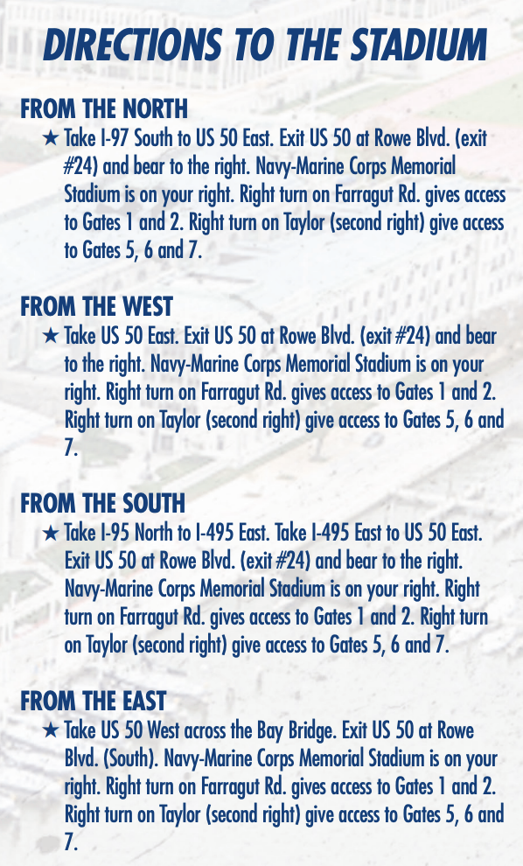
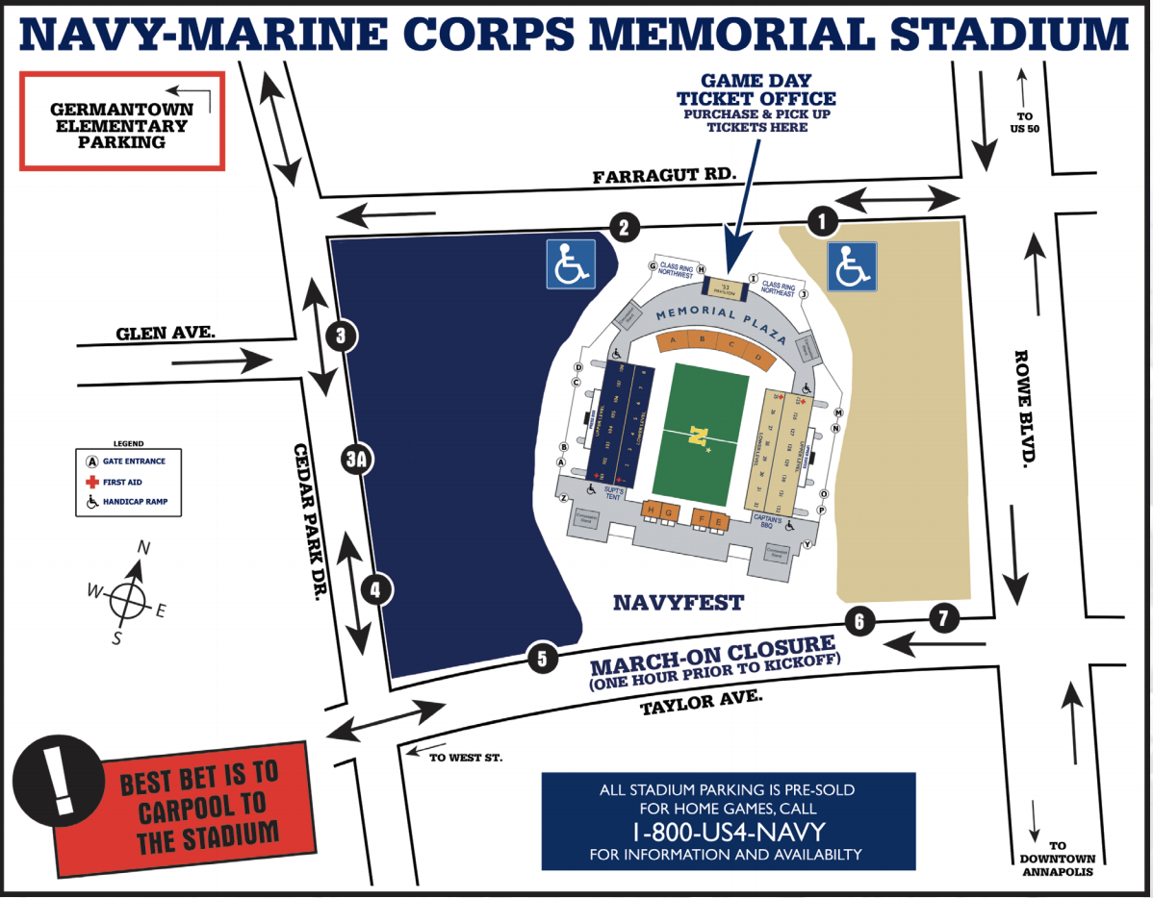

Class of 1980 40th + Reunion Map of Tailgate/Watch Party
Adapted from Naval Academy Athletic Association Parking Guide
Tailgate/Watch Party
N* Room (Blue Side)
Saturday, 1-7 p.m.
Enter Gate C
Registration/Nametag pickup
12:30 p.m.-3 p.m.
Event Parking
11 a.m. – 7:30 p.m.
$10 to be paid by driver
Enter Gate 5 off Taylor Ave

Slide 2
