Slide 1

U.S. Naval Academy Class of 1980 Annual Meeting
November 5, 2021
Mitscher Hall

Slide 2
Meeting Agenda
Welcome 5 Mins
Reunion Update 5 Mins
2021 – 2022 10 Mins
Treasurer’s Report 5 Mins
Secretary’s Report 5 Mins
Outreach Officer’s Report 5 Mins
Class Governance 10 Mins
Recognition 5 Mins
Open Microphone 10 Mins

Slide 3

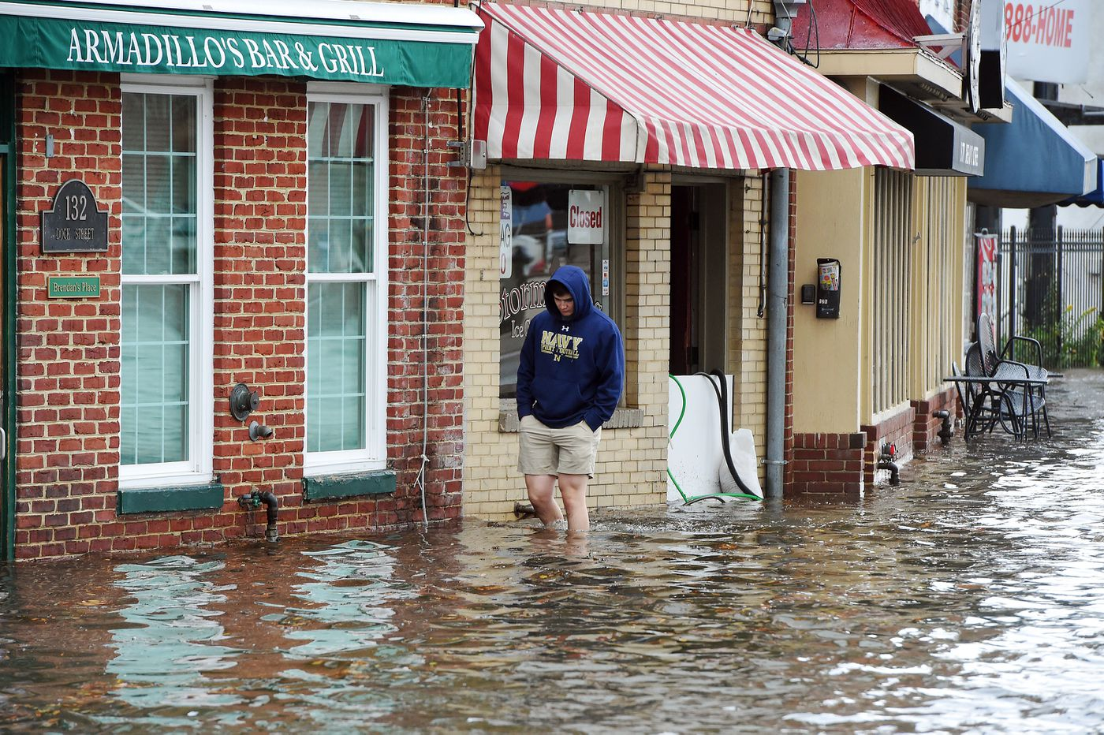



Time, Tide and (COVID 19) Formation…
X
September
2020
X
April
2021
Photo by Paul W. Gillespie, Capital Gazette
…cannot stop the
Great Class of 1980!
November
2021
This Photo by Unknown Author is licensed under CC BY-SA

Slide 4
Updated Reunion Gouge
Text USNA 1980 to 833-269-9912 for reunion updates
Limit to receive only please
Bus service
Registration
Tailgate/Parking

Slide 5
Year in Review – Year Ahead
Elections (VP & Treasurer)
By-Laws
Elections (Pres, Secretary, & Outreach)
VCNO!
NAAA Athletic Legends
Fundraising Awareness
Reunion Committee Recognition

Slide 6
Treasurer’s Report
Operating Account
Funds pooled with Alumni Association for maximum return
Revenue
Interest from Alumni Association investments
Percentage of profit from preferred vendors
Contributions made by individuals
Reunion/special events
Expenses
Tailgate spot at Navy Marine Corps Memorial Stadium
Flowers/recognition of life events
Reunion/special events

Slide 7
Class of 1980 Operational Account Financials
Fiscal Year 2021 (7/1/20 – 6/30/21)
Beginning Balance $29,128.92
Income
Vendors $361.70
Investment/Dividend $228.74
Total Income $590.44
Expenses
Memorial (flowers) $114.90
Tailgate Spot $1,200.00
Total Expenses $1,314.90
Ending Balance $28,404.46
Fiscal Year 2022 (7/1/21 –Present*)
Beginning Balance $28,404.46
Income
Vendors $158.74
Investment/Dividend $ 51.07
Reunion Fees $87,000.00
Total Income $87,209.81
Expenses
Reunion Expenses $610.99
Total Expenses $610.99
Ending Balance $115,003.28 *Through 10/22/21

Slide 8
Secretary’s Report
Shipmate
Company Reps
Communications
Team Sport - changing times
“I hope that this morning we find each of you healthy, happy and wiser today than yesterday. Please take a few minutes to renew a friendship, call/Teams/text/ Zoom/visit a Classmate and take care of each other – you never know what a difference you can make!”

Slide 9
Outreach and Representation Officer’s Report
Goal #1 : To ensure the leadership of the Class is representative
Goal #2 : Make all Classmates feel included & welcome
Goal #3: Assist Classmates in need
We welcome your ideas and participation on committees

Slide 10
Class Governance
New By-Laws
Filled five elected positions
Focused on the Reunion
Will be filling four appointed positions
Will solicit volunteers with certain skills
Re-invigorated Company Reps Participation
Improve Comms and Feedback
Likely to add Battalion Reps
Add-On to 2021-2022
Janie Mines – First Class of ‘80
Distinguished Grad!

Slide 11

PAST PRESIDENT RECOGNITION

Slide 12

OPEN MICROPHONE

