Slide 1
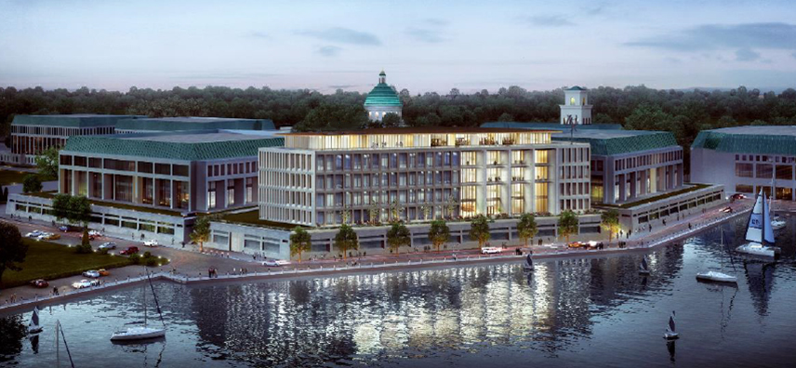
Cyber Security Studies Building
Groundbreaking - Oct 21, 2016

Slide 2
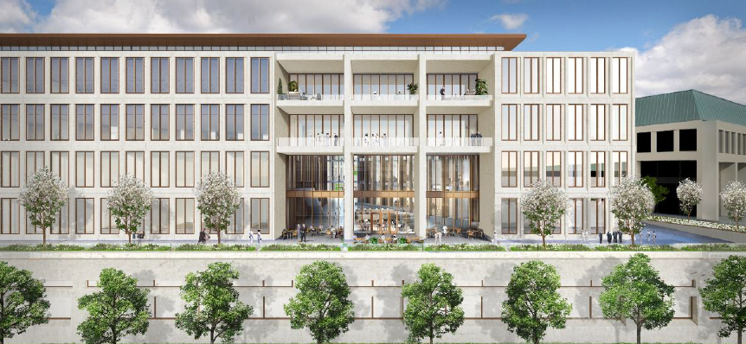
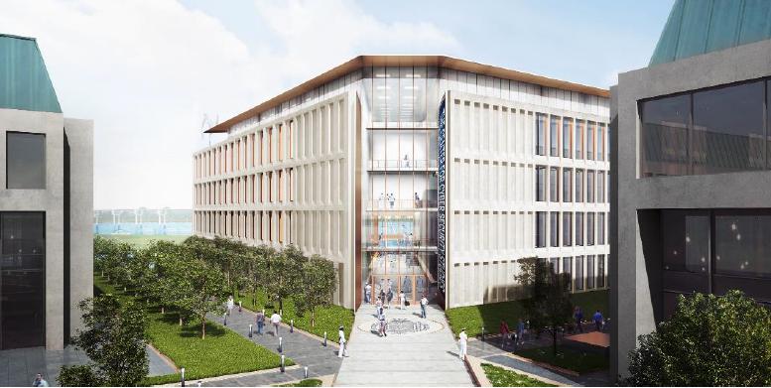
Cyber Security Studies Building

Slide 3
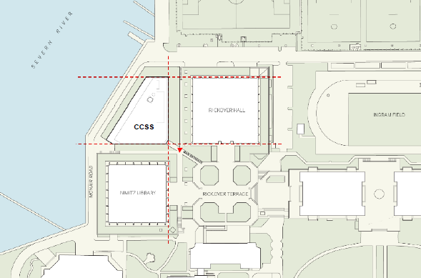
Cyber Security Studies Building

Slide 4
Cyber Security Studies Building
Primary Occupants:
Cyber Center
Cyber Science Department
Electrical and Computer Engineering (partial requirements)
Weapons and Systems Engineering (partial requirements)
Computer Science
Naval Architecture and Ocean Engineering (PBL and Research Space)
Key Talking Points:
206,000 Gross Square Feet of new academic space
Funded from FY2015 Military Construction Program (MILCON)
$120.1M for Building and Garage
Building is currently in design
Planning Schedules:
Garage: Currently in Construction:
Design Complete: October 2014
Award Construction Contract: April 2015
Construction Start: June 2015
Substantial Completion: October 2016
Building: Currently in Design:
Award Design-Build Contract: March 31, 2016
Groundbreaking: October 21, 2016
Design Complete: Spring 2017
Substantial Completion: Spring 2019
Occupy Building: Summer 2019

